Slide 1

23ECE381 Open Laboratory I
DIGITAL LOCKING SYSTEM WITH UNAUTHORIZED ACCESS ALERT
Presented By :23ECE381C10
Group Members:
Chittesh S(CB.EN.U4ECE23212)
Sricharan R P(CB.EN.U4ECE23246)
Sujith Krishna P G(CB.EN.U4ECE23249)

Slide 2

OVERVIEW
Objectives
Block Diagram
Circuit Diagram
Design
Analysis
References

Slide 3
OBJECTIVES
To develop a digital locking system using only digital logic circuits
To integrate a keypad for password entry
To make the saved password customizable
To provide visual and audio indication for password verification
To test logic sequence, reset, and correct code detection mechanisms.

Slide 4
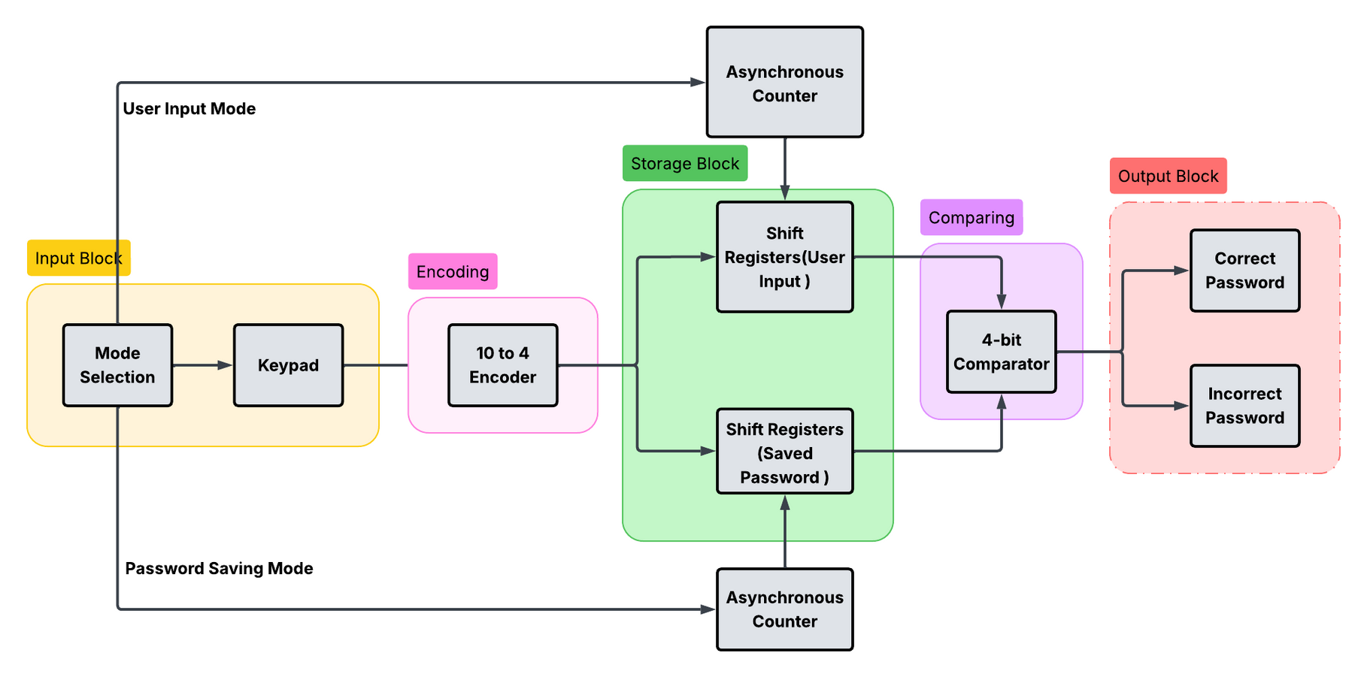
BLOCK DIAGRAM

Slide 5
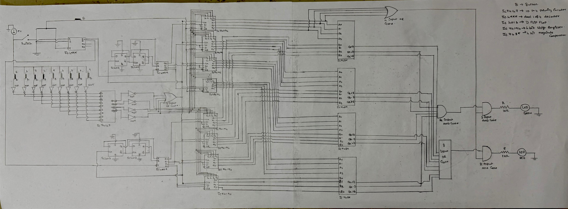
CIRCUIT DIAGRAM

Slide 6
DESIGN
Procedure:
When a button is pressed, it provides an active-low signal to a priority encoder. To work with active-high logic, NOT gates are placed at both the input and output of the encoder.
An Enter button with a demultiplexer switches between password set mode and unlock mode, storing the 4-bit binary input in shift registers
D flip-flop, configured as a counter, works with the demultiplexer to automatically route each entered digit to the next shift register in sequence.

Slide 7
DESIGN
Procedure:
The core authentication is handled by 4-bit magnitude comparators. These ICs compare the binary value from the "user input" registers against the "saved password" registers (B inputs)
Correct Password: A 4-input AND gate is connected to the A=B outputs of all comparators. If all digits match, this gate's output goes HIGH, which turns on the green led
Incorrect Password: An 8-input OR gate is connected to all A>B and A<B outputs of the comparators. If any digit is mismatched, this gate's output goes HIGH, which activates the red LED and the buzzer.

Slide 8
DESIGN
Choice of Components
Push Buttons
74147 – 10-to-4 Line Encoder
74194 – 4-Bit Bidirectional Shift Register
4013 – D-Type Flip-Flop
4555 – Dual 1-to-4 Decoder/Demultiplexer
AND Gates
OR Gates
NOT Gates
7485 – 4-Bit Magnitude Comparator
Green LED
Red LED

Slide 9
ANALYSIS
Keypad & Encoder: User presses a button (e.g., ‘8’) → Encoder outputs 4-bit binary 1000.
Reset Function:
Reset button clears user input shift registers → system ready for retry.
Comparator Stage:
A inputs = User-entered digits.
B inputs = Saved password digits.
If match → A=B = HIGH;
If mismatch → A<B or A>B = HIGH.
Final Logic Output:
Correct Password: All A=B HIGH → 4-input AND → Green LED
Incorrect Password: Any mismatch → 8-input OR → Red LED

Slide 10
REFERENCES
[1] S. H. Kumar, Electronics Project, vol. 15: Programmable Number Lock.
[2] “GSM Based Digital Door Lock Security System,” in 2015 IEEE International Conference on Power, Instrumentation, Control and Computing (PICC), 2015.
[3] “A Practical Digital Door Lock for Smart Home,” in 2018 IEEE International Conference on Consumer Electronics (ICCE), 2018.
[4] “The Design and Construction of a 2-Digit Electronic Lock System Using Simple Circuit Elements and Digital Electronic Logic Gates,” ResearchGate, Mar. 15, 2017.
[5] “Simple Combination Lock,” All About Circuits. [Online]. Available: https://www.allaboutcircuits.com/textbook/experiments/chpt-7/simple-combination-lock/.
[6] “Electronic Code Lock System Using IC,” Instructables. [Online]. Available: https://www.instructables.com/Electronic-Code-Lock-System-Using-IC/.
[7] “Digital Code Lock Circuit Without Microcontroller,” Gadgetronicx. [Online]. Available: https://www.gadgetronicx.com/digital-code-lock-circuit-without-microcontroller/.

Slide 11


THANK YOU

